Slide 1

A Project Review Meeting on student innovation startup cell portal
By
T. Parinitha 2520030562
P. Anuradha Nandini 2520030171
Under the guidance of
Pavithra Duggineni
Associate Professor
Department of Computer Science and Engineering
Koneru Lakshmaiah Education Foundation (Deemed to be University estd. u/s. 3 of the UGC Act, 1956) Off-Campus: Bachupally-Gandimaisamma Road, Bowrampet, Hyderabad, Telangana - 500 043. Phone No: 7815926816, www.klh.edu.in

Slide 2
Abstract
The Student Innovation & Startup Cell Portal is a web-based platform designed to promote innovation, entrepreneurship, and startup development within academic institutions. It provides students with a structured environment to transform ideas into practical business solutions by offering tools for startup registration, proposal submission, and incubation program applications through an intuitive interface.
The system streamlines administrative processes by allowing administrators to review applications, evaluate proposals, and assign mentors based on expertise. Mentors guide students throughout the development process, offering feedback and tracking progress at various stages. A built-in progress monitoring system helps track milestones, achievements, and overall performance, ensuring transparency and accountability.
The portal also functions as an inspiration hub by showcasing successful startup stories, motivating students to engage in innovation-driven activities. A notification system keeps users updated on application statuses, mentoring sessions, and important announcements, ensuring smooth communication among all stakeholders.
Additionally, the platform maintains detailed records of all activities and provides report generation features for better documentation and analysis. Built using modern technologies like React.js for the frontend and Node.js with Express.js for the backend, the portal ensures high performance, scalability, and reliability.
Overall, the Student Innovation & Startup Cell Portal enhances collaboration, simplifies startup management, and fosters a culture of creativity and entrepreneurship, making it a valuable tool for institutions aiming to support and nurture future innovators and business leaders.

Slide 3
Introduction
The Student Innovation & Startup Cell Portal is a comprehensive web-based platform designed to foster innovation, entrepreneurship, and startup culture within academic institutions. It provides students with a centralized environment to transform innovative ideas into viable business solutions by facilitating startup registration, proposal submission, incubation applications, and mentorship support.
The portal streamlines the interaction between students, mentors, and administrators through an intuitive and user-friendly interface. It enables efficient application management, progress tracking, mentor assignment, and communication while ensuring transparency throughout the startup development lifecycle.
By showcasing success stories, monitoring achievements, and generating analytical reports, the system encourages creativity, collaboration, and entrepreneurial thinking. Built with modern technologies such as React.js, Node.js, and Express.js, the platform delivers a scalable, reliable, and high-performance solution for nurturing future innovators and startup founders.

Slide 4
Problem Statement
Many students possess innovative ideas and entrepreneurial potential but face challenges in transforming their concepts into successful startups due to the lack of a centralized platform for idea management, mentorship, incubation support, and progress tracking. Existing processes for startup registration, proposal evaluation, mentor assignment, and communication are often manual, fragmented, and time-consuming, leading to inefficiencies and limited collaboration among stakeholders.
Academic institutions also struggle to effectively monitor student startup activities, maintain records, evaluate performance, and provide timely guidance. The absence of a structured system can result in poor coordination, delayed decision-making, and reduced opportunities for students to receive the support needed to develop their innovations.
Therefore, there is a need for an integrated digital solution that streamlines startup management, facilitates collaboration between students, mentors, and administrators, tracks progress transparently, and promotes a culture of innovation and entrepreneurship within educational institutions.

Slide 5
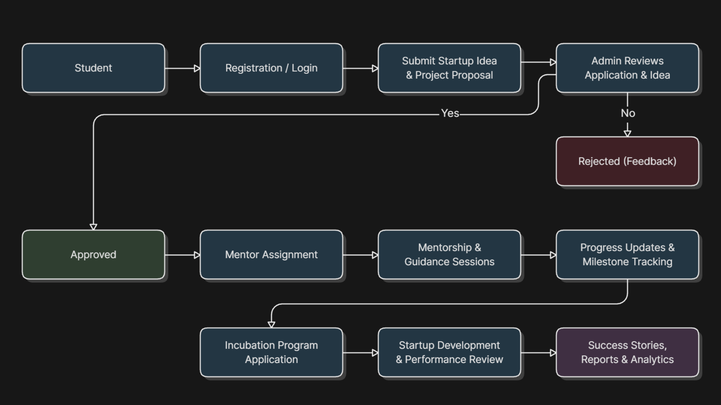
Project Flow Diagram

Slide 6
Objectives with Justification
Objectives
Create a centralized startup management platform.
Simplify startup registration and proposal submission.
Enable efficient mentor allocation and guidance.
Track startup progress and milestones.
Automate application review and approval processes.
Improve communication through notifications.
Generate reports and maintain records.
Encourage innovation and entrepreneurship.
Showcase startup success stories.
Provide a secure, scalable, and user-friendly system.
Justification: The portal addresses the lack of a structured system for managing student innovations and startup activities by improving collaboration, transparency, efficiency, and entrepreneurial development within academic institutions.

Slide 7
Modules [Frontend web pages]
👤 Authentication Module
Registration Page
Login Page
🎓 Student Module
Student Dashboard
Startup Registration
Proposal Submission
Progress Tracking
👨‍🏫 Mentor Module
Mentor Dashboard
Startup Evaluation
Feedback Management
.
⚙️ Admin Module
Admin Dashboard
Application Review
Mentor Assignment
Report Generation
📢 General Module
Home Page
Success Stories
Notifications
User Profile

Slide 8
Expected Outcomes of the Proposed Work
Centralized startup and innovation management.
Faster application review and approval process.
Improved student engagement in entrepreneurship.
Efficient mentor-student collaboration.
Transparent progress and milestone tracking.
Better communication through notifications.
Secure record management and documentation.
Automated report generation and analytics.
Increased innovation and startup success rates.
Scalable, reliable, and user-friendly platform.

Slide 9
Conclusion and Future Scope
Conclusion:
The Student Innovation & Startup Cell Portal provides a centralized and efficient platform for managing innovation and entrepreneurship activities within academic institutions. It simplifies startup registration, proposal submission, mentor assignment, progress tracking, and administrative management through a user-friendly digital environment. By improving collaboration among students, mentors, and administrators, the portal promotes transparency, accountability, and effective communication. The system ultimately fosters a culture of innovation and supports students in transforming their ideas into successful startup ventures.
Future Scope:
AI-powered proposal evaluation.
Mobile application support.
Investor and industry expert integration.
Funding and incubation management.
Advanced analytics and reporting.
Cloud-based scalable deployment.

Slide 10
References

Slide 11
Thank you

